Slide 1
Machine Learning Final Project Neural Machine Translation
Group Members: 11811126 Yulun ZHUANG
11811737 Mandan CHAO
11711612 Baiyue WANGa

Slide 2
ME338 Final Project
Neural Machine Translation from German to English with Transformer on Multi30k Dataset
Algorithm Implementation
Experimental Results
Notes:
Dataset information
Structure of this video

Slide 3
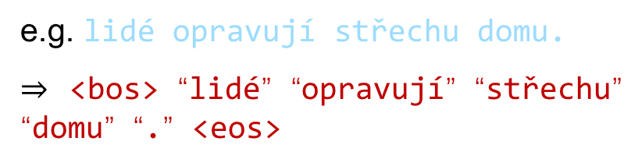
ME338 Final Project - Algorithm Implementation
Tokenization
tokenize the sentences into words
e.g. lidé opravují střechu domu.
$⇒$ <bos> “lidé” “opravují” “střechu” “domu” “.” <eos>
Building Vocabulary
use a dictionary(hash table) to count word frequencies
e.g.
word | frequency
into | 1
sentence | 1
is | 2
Data Preparation
One-Hot Encoding
map words to a list of indices
Batchtify
sentence pairs were batched together by approximate sequence length
Sentences Aligning
pad sentences with zeros to the maximum length in one batch

Slide 4
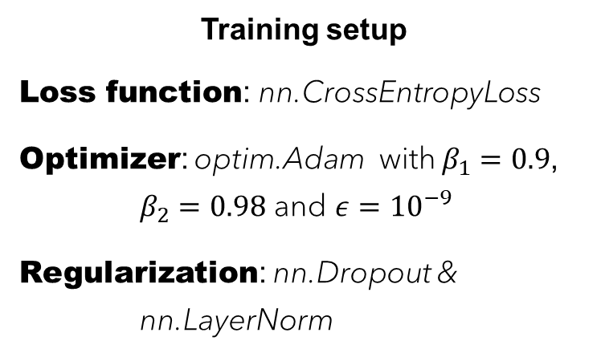
ME338 Final Project - Algorithm Implementation
Embedding Layer
Positional Encoding Layer
Attention parameters: queries Q, keys K, values V
Encoder
Decoder
Training setup
Loss function: nn.CrossEntropyLoss
Optimizer: optim.Adam with $β_{1}=0.9$, $β_{2}=0.98$ and $ε={10}^{−9}$
Regularization: nn.Dropout & nn.LayerNorm
Attention-based Model
Beam Search

Slide 5
ME338 Final Project - Algorithm Implementation
Encoder Output
Decoder Output
Decoder
Encoder
Add & Norm
Add & Norm
Feed Forward
Feed Forward
Add & Norm
Add & Norm
Multi-head Attention
$$K, V$$
$$Q$$
Encoder Output
Multi-head Attention
Add & Norm
$$K, Q, V$$
Masked Multi-head Attention
+
Positional Encoding
Input Embeddings
+
Positional Encoding
Input Embeddings
Input
Output

Slide 6
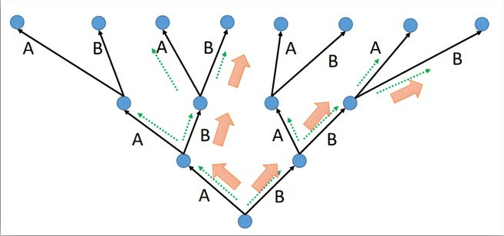
ME338 Final Project - Algorithm Implementation
Aim to maximize the model prediction $P\left(y\right|x=x; θ)$ as the translation
keep track of k states during the inference stage.
each state is a tuple [candidate translation, log-probability of the candidate]
each step, all the successors of all k states are generated, but only the top-k successors are selected.
The algorithm usually terminates when the step exceed a pre-defined value or k full translation are found.
Beam search diagram
Notes:
Given an NMT model and a source sentence x, how to generate a translation from the model is an important problem.
But intractably large search space makes it impractical to find the translation with the highest probability. Therefore, NMT could use beam search to find a local best translation which is a classic local search algorithm widely used in NMT.
Specially, it should be noted that the beam search will degrade into the greedy search if k = 1.

Slide 7
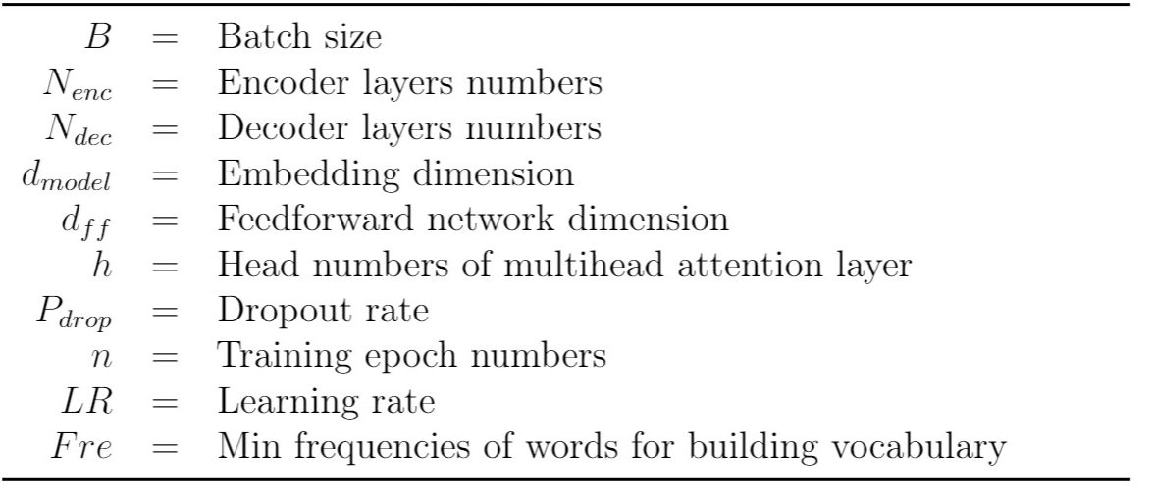
ME338 Final Project - Experimental Results
In our hyperparameters tuning, there are 10 hyperparameters affecting the model performance significantly, which are shown in right diagram.
To achieve higher BLEU score from transformer we trained our model in different hyperparameters, and we recorded these model.

Slide 8
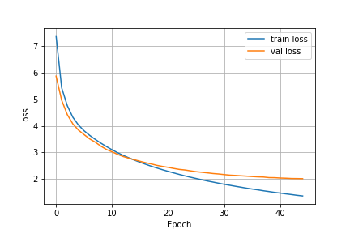
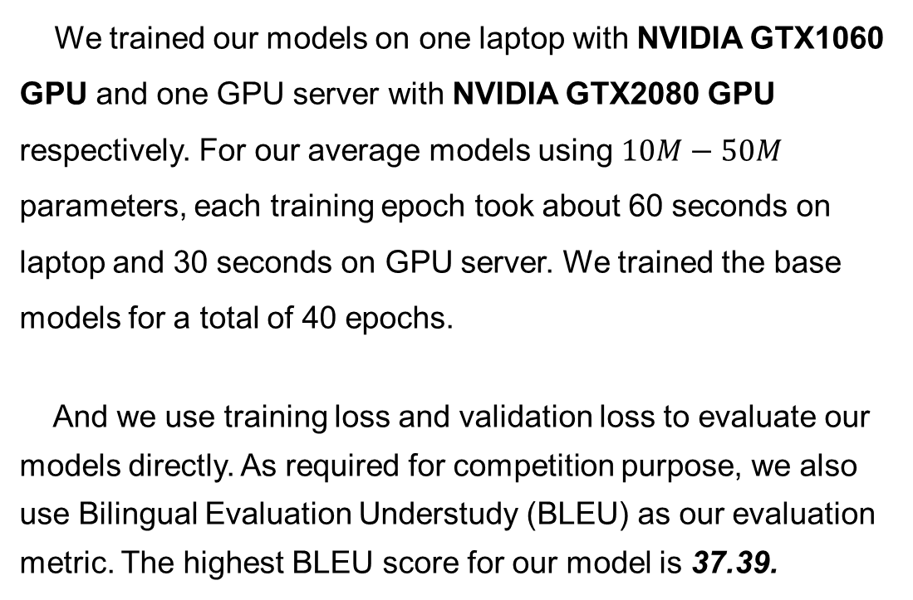
ME338 Final Project - Experimental Results
We trained our models on one laptop with NVIDIA GTX1060 GPU and one GPU server with NVIDIA GTX2080 GPU respectively. For our average models using $10M−50M$ parameters, each training epoch took about 60 seconds on laptop and 30 seconds on GPU server. We trained the base models for a total of 40 epochs.
And we use training loss and validation loss to evaluate our models directly. As required for competition purpose, we also use Bilingual Evaluation Understudy (BLEU) as our evaluation metric. The highest BLEU score for our model is 37.39.

Slide 9
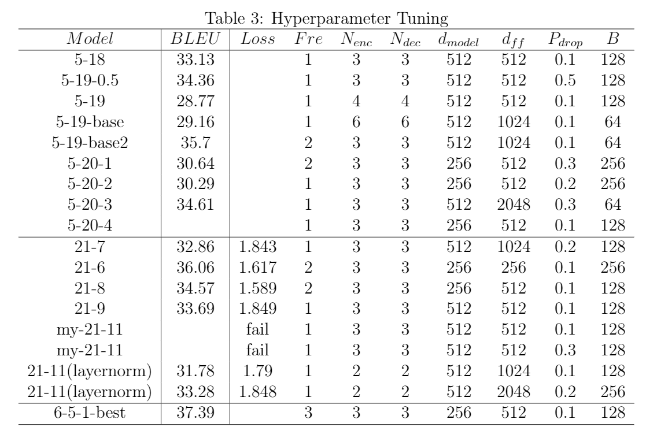
ME338 Final Project - Experimental Results
In the table rows 1 to 4, the embedding size varies from 512 to 1024 and encountered great overfitting due to the large number of embedding layer parameters.
We further observe in rows 11 and 12 that, not as expected, bigger models are not better, and dropout is very helpful in avoiding over-fitting.

Slide 10
ME338 Final Project - Experimental Results
We have also encountered two strange evidences.
Due to the difference of PyTorch version, we get different vocabulary size from laptop to server with same code. That is to say, the model we trained on server can not be evaluated on local laptop.
Another strange point is that BLEU score keep raising as the min frequencies of words for building vocabulary increasing. As Fre increasing from 1 to 3, the highest BLEU scores raising from 34.36 to 37.39.

Slide 11
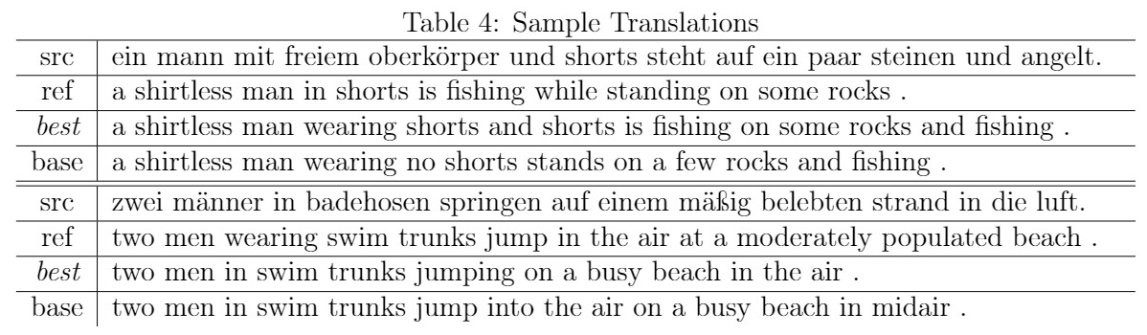
ME338 Final Project - Experimental Results

Slide 12
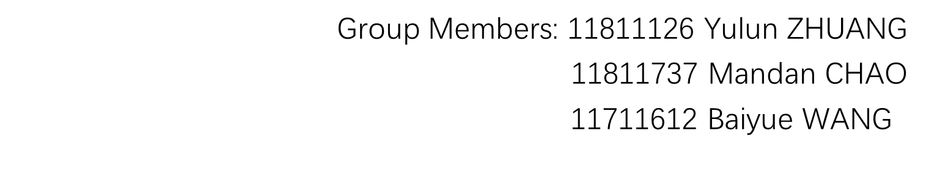
ME338 Final Project
Thanks for your listening!

